Slide 1
Error Control Codes
Course Code: COE 3206
Course Title: Computer Networks
Dept. of Computer Science
Faculty of Science and Technology
Lecturer No: | 8 | Week No: | 09 | Semester: | Summer 23-24
Lecturer: | Md. Faruk Abdullah Al Sohan; faruk.sohan@aiub.edu

Slide 2
Lecture Outline
Cyclic redundancy check
Linear block code

Slide 3
Cyclic Redundancy Check
Introduction
What if the transmitted bits get altered on the way?
Is there any technique to detect the error?
Yes, using Cyclic Redundancy Check (CRC)
CRC
In CRC, some redundant bits are sent in addition to the message bits.
The purpose of the redundant bits is to facilitate detecting error.
The redundant bits are called frame check sequence (FCS)
How is FCS generated?

Slide 4
Cyclic Redundancy Check….
Introduction….
Strength of the CRC depends on the number of redundant bits (that is, FCS length)
Longer FCS length results in better accuracy in detecting error
Required two sequence
Message sequence, M
The desired data to be sent
Can be of any length
Pattern sequence, P
Known to both sender and receiver
If we want to use K bits FCS, we need a pattern bit sequence, P, of length K+1 bits.

Slide 5
Cyclic Redundancy Check….
Generation of FCS
Decide how many FCS bits, K, you are going to use.
Append K zeros at the end of the message bits to generate M+K bits long sequence S.
Select a K+1 bits long pattern sequence, P.
Divide the sequence S by the pattern sequence P to find the K bits of the remainder, R.
Remove the appended zeros from S and append the calculated remainder R Thus, the N bits message bits and K bits remainder constitutes the transmitting sequence, T.

Slide 6
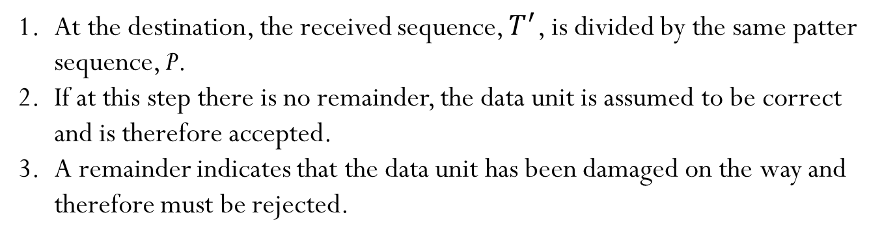
Cyclic Redundancy Check….
Error detection at the receiver
At the destination, the received sequence, $T^{′}$, is divided by the same patter sequence, P.
If at this step there is no remainder, the data unit is assumed to be correct and is therefore accepted.
A remainder indicates that the data unit has been damaged on the way and therefore must be rejected.

Slide 7
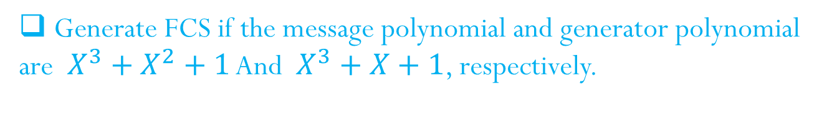
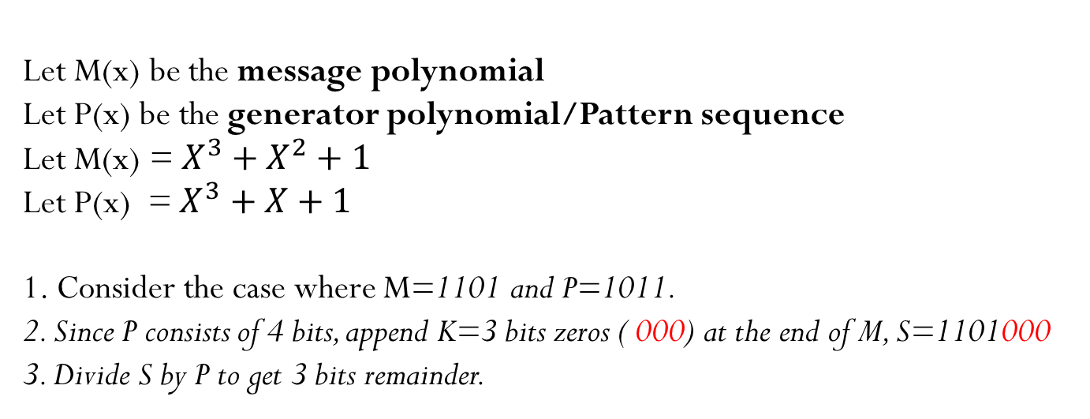
Cyclic Redundancy Check….
Example 1
Generate FCS if the message polynomial and generator polynomial
are $X^{3}+X^{2}+1$ And $X^{3}+X+1$, respectively.
Let M(x) be the message polynomial
Let P(x) be the generator polynomial/Pattern sequence
Let M(x) = $X^{3}+X^{2}+1$
Let P(x) = $X^{3}+X+1$
1. Consider the case where M=1101 and P=1011.
2. Since P consists of 4 bits, append K=3 bits zeros ( 000) at the end of M, S=1101000
3. Divide S by P to get 3 bits remainder.
1 1 0 1
1 0 1 1

Slide 8
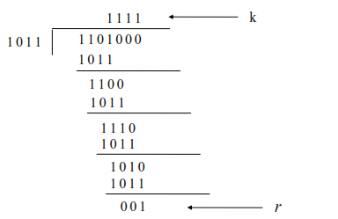
Cyclic Redundancy Check….
Example 1
At sender
P
S
Transmit sequence or codeword
T = 1 1 0 1 0 0 1
R

Slide 9
Cyclic Redundancy Check….
Example 1
At Receiver
1011
1 1 0 1 0 0 1
1 0 1 1
1 1 0 0
1 0 1 1
1 1 1 0
1 0 1 1
1 0 1 1
1 0 1 1
0 0 0 0
Since the remainder is zero, there is no error in the received sequence

Slide 10
Cyclic Redundancy Check….
Example 1
What if any bit gets altered in the channel?
Suppose that the second bit (red) has altered from 1 to 0.
1011
1 0 0 1 0 0 1
1 0 1 1
1 0 0 0
1 0 1 1
1 1 1
The nonzero remainder indicates an erroneous reception.
The frame will not be acknowledged.
The sender will resend the frame.

Slide 11
Cyclic Redundancy Check….
Example 2
Message M = 1010001101
Pattern P = 110101
Length of P=6
Append K=6-1=5 zeros at the end of M
S=101000110100000
Now divide S by P to find 5 bits remainder [1].

Slide 12
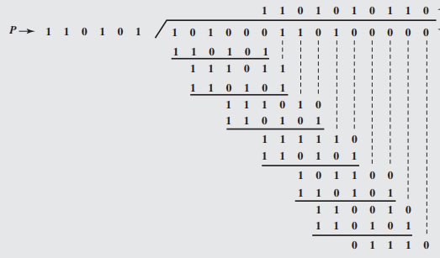
Cyclic Redundancy Check….
Example 2
Transmitted sequence, T=101000110101110
At the receiving end, T is divided by P to see if the remainder is zero. The zero remainder indicates error free reception.

Slide 13
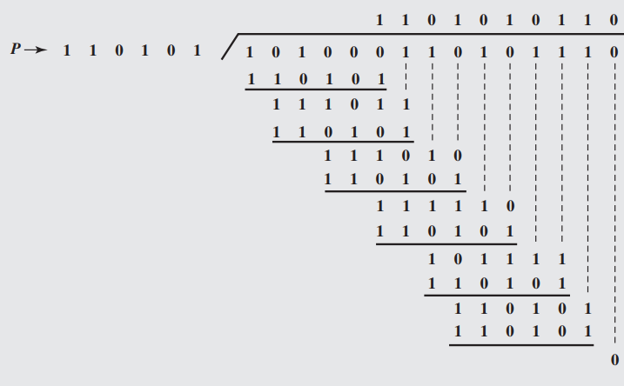
Cyclic Redundancy Check….
Example 1
Because there is no remainder, it is assumed that there have been no errors.

Slide 14
Homework
Detect whether the received sequence 101110101 is error free if the pattern sequence is 1010.

Slide 15
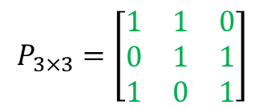
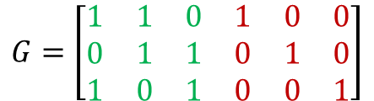

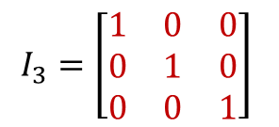


Linear Block Code
Generator Matrix
Linear Block Code: A code in which addition of any two codewords gives another
codeword [2].
Message, M: k bits long
Redundant bits, Q: q bits long
Codeword length, N: k+q bits long
Generator matrix,
$$G=\left[P_{k×q}I_{k}\right]$$
$$P_{3×3}=\left[\begin{matrix}1 & 1 & 0 \\ 0 & 1 & 1 \\ 1 & 0 & 1\end{matrix}\right]$$
For
$$k=3$$
and
q$=3$
,
$$G=\left[\begin{matrix}1 & 1 & 0 & 1 & 0 & 0 \\ 0 & 1 & 1 & 0 & 1 & 0 \\ 1 & 0 & 1 & 0 & 0 & 1\end{matrix}\right]$$
$$I_{3}=\left[\begin{matrix}1 & 0 & 0 \\ 0 & 1 & 0 \\ 0 & 0 & 1\end{matrix}\right]$$
Then, it is a (n, k) =(6, 3) block code

Slide 16


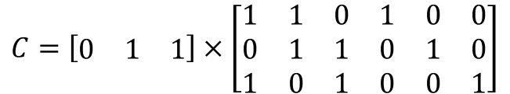








Linear Block Code….
Codeword calculation
Modulo-2 summation
The codeword for the message [ 0 1 1] is
$$0×11×01×1=1$$
$$C=M×G$$
$$0×11×11×0=1$$
$$C=\left[\begin{matrix}0 & 1 & 1\end{matrix}\right]×\left[\begin{matrix}1 & 1 & 0 & 1 & 0 & 0 \\ 0 & 1 & 1 & 0 & 1 & 0 \\ 1 & 0 & 1 & 0 & 0 & 1\end{matrix}\right]$$
$$0×01×11×1=0$$
$$0×11×01×0=0$$
$$0×01×11×0=1$$
$$C=\left[\begin{matrix}1 & 1 & 0 & 0 & 1 & 1\end{matrix}\right]$$
$$0×01×01×1=1$$
$$Q$$
$$M$$

Slide 17



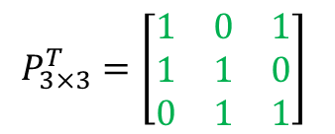
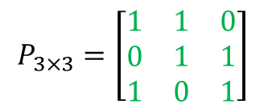
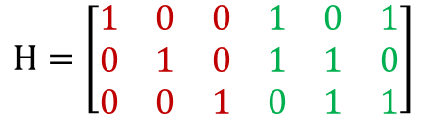
Linear Block Code….
Error-detection
Receiving end
$$P_{3×3}=\left[\begin{matrix}1 & 1 & 0 \\ 0 & 1 & 1 \\ 1 & 0 & 1\end{matrix}\right]$$
Parity check matrix,
$$H=\left[I_{q} P_{k×q}^{T}\right]$$
$$P_{3×3}^{T}=\left[\begin{matrix}1 & 0 & 1 \\ 1 & 1 & 0 \\ 0 & 1 & 1\end{matrix}\right]$$
$$H=\left[I_{3} P_{3×3}^{T}\right]$$
$$H=\left[\begin{matrix}1 & 0 & 0 & 1 & 0 & 1 \\ 0 & 1 & 0 & 1 & 1 & 0 \\ 0 & 0 & 1 & 0 & 1 & 1\end{matrix}\right]$$
$P_{3×3}^{T}$ is the transpose of $P_{3×3}$

Slide 18
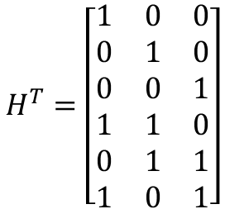

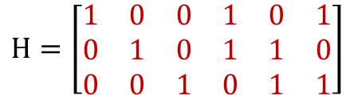
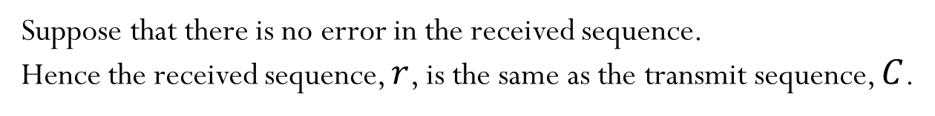
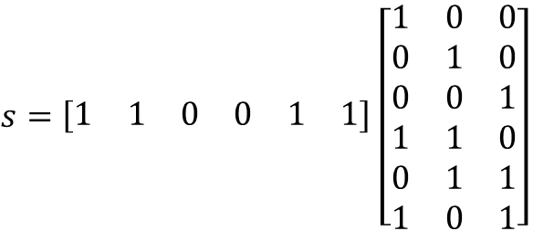



Linear Block Code….
Error-detection….
Suppose that there is no error in the received sequence.
Hence the received sequence, $r$, is the same as the transmit sequence, $C$.
$$r=C$$
$$r=\begin{matrix}[1 & 1 & 0 & 0 & 1 & 1]\end{matrix}$$
$$H=\left[\begin{matrix}1 & 0 & 0 & 1 & 0 & 1 \\ 0 & 1 & 0 & 1 & 1 & 0 \\ 0 & 0 & 1 & 0 & 1 & 1\end{matrix}\right]$$
Syndrome,
$$s=rH^{T}$$
$s=\begin{matrix}[1 & 1 & 0 & 0 & 1 & 1]\end{matrix}$ $\left[\begin{matrix}1 & 0 & 0 \\ 0 & 1 & 0 \\ 0 & 0 & 1 \\ 1 & 1 & 0 \\ 0 & 1 & 1 \\ 1 & 0 & 1\end{matrix}\right]$
$$H^{T}=\left[\begin{matrix}1 & 0 & 0 \\ 0 & 1 & 0 \\ 0 & 0 & 1 \\ 1 & 1 & 0 \\ 0 & 1 & 1 \\ 1 & 0 & 1\end{matrix}\right]$$
$$s=\left[\begin{matrix}0 & 0 & 0\end{matrix}\right]$$
The all-zero syndrome indicates a correct reception !

Slide 19


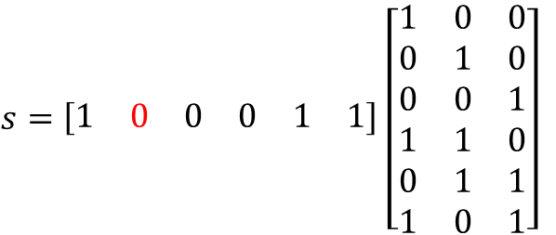
Linear Block Code….
Error-detection….
Suppose that there is an error in the received sequence.
The second bit (from left side) has altered from 1 to 0
$$r=\begin{matrix}[1 & 0 & 0 & 0 & 1 & 1]\end{matrix}$$
Syndrome,
$$s=rH^{T}$$
$s=\begin{matrix}[1 & 0 & 0 & 0 & 1 & 1]\end{matrix}$ $\left[\begin{matrix}1 & 0 & 0 \\ 0 & 1 & 0 \\ 0 & 0 & 1 \\ 1 & 1 & 0 \\ 0 & 1 & 1 \\ 1 & 0 & 1\end{matrix}\right]$
$$s=\left[\begin{matrix}0 & 1 & 0\end{matrix}\right]$$
The non-zero syndrome indicates an erroneous reception !

Slide 20

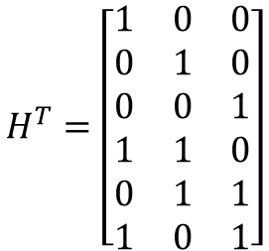
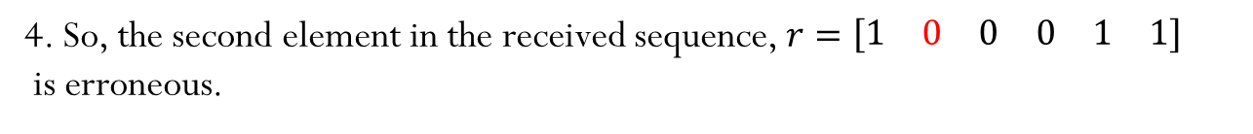

Linear Block Code….
Error-correction
How to correct the error?
$$H^{T}=\left[\begin{matrix}1 & 0 & 0 \\ 0 & 1 & 0 \\ 0 & 0 & 1 \\ 1 & 1 & 0 \\ 0 & 1 & 1 \\ 1 & 0 & 1\end{matrix}\right]$$
1. Syndrome ,
$$s=\left[\begin{matrix}0 & 1 & 0\end{matrix}\right]$$
2. Locate the syndrome in $H^{T}$
3. It is in second row
4. So, the second element in the received sequence, $r=\begin{matrix}[1 & 0 & 0 & 0 & 1 & 1]\end{matrix}$
is erroneous.
4. Alter the second bit from 0 to 1.
5. So, the correct received sequence is [ 1 1 0 0 1 1].
Note: The given generator matrix enables correction of at most 1 bits.
It is possible to correct more bits , but it requires quite a lot work! No Free Lunch!

Slide 21
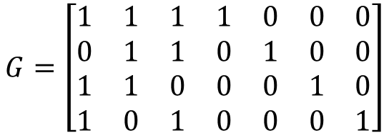
Homework
Consider a (7, 4) code whose generator matrix is given by
Message bit [1 0 1 0]
$$G=\left[\begin{matrix}1 & 1 & 1 & 1 & 0 & 0 & 0 \\ 0 & 1 & 1 & 0 & 1 & 0 & 0 \\ 1 & 1 & 0 & 0 & 0 & 1 & 0 \\ 1 & 0 & 1 & 0 & 0 & 0 & 1\end{matrix}\right]$$
Find all the codewords of the code
Find the parity-check matrix
Find the syndrome for the received vector [ 1 1 0 1 0 1 0]. Is it a valid codeword?

Slide 22
References
[1] W. Stallings, Data and Computer Communication, 10th ed., Pearson
Education, Inc., 2014, USA, pp. 194 - 196.
[2] B. Sklar, Digital Communications, 2nd ed., Prentice Hall. 2017, USA, pp. 328 - 345.

Slide 23
Recommended Books
Data Communications and Networking, B. A. Forouzan, McGraw-Hill, Inc., Fourth Edition, 2007, USA.
Computer Networking: A Top-Down Approach, J. F., Kurose, K. W. Ross, Pearson Education, Inc., Sixth Edition, USA.
Official Cert Guide CCNA 200-301 , vol. 1, W. Odom, Cisco Press, First Edition, 2019, USA.
CCNA Routing and Switching, T. Lammle, John Wily & Sons, Second Edition, 2016, USA.
TCP/IP Protocol Suite, B. A. Forouzan, McGraw-Hill, Inc., Fourth Edition, 2009, USA.
Data and Computer Communication, W. Stallings, Pearson Education, Inc., Tenth Education, 2013, USA.

